Slide 1
Eugenics
Designer Babies
By PresenterMedia.com

Slide 2
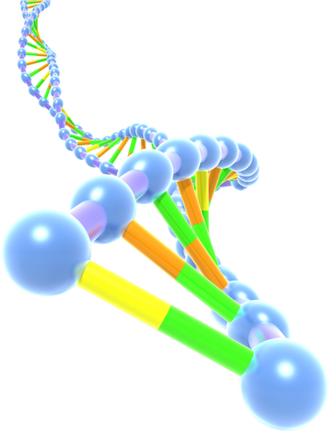
What is Eugenics?
Improving a human population by controlled breeding to increase the occurrence of desirable heritable characteristics.
Francis Galton
Developed by Francis Galton as a method of improving human race
Origin
France, Germany, Great Britain and the United States in the 1860s-1870s
Disfavor
It fell into disfavor only after the perversion of its doctrines by the Nazis
Supporters
Winston Churchill, Alexander Graham Bell, Theodore Roosevelt and Calvin Coolidge

Slide 3
Eugenics
History
The general concept of eugenics is first mentioned in Greek records dating back to 368 BC. Plato and Aristotle both refer to the city state's need for healthy citizens to form an elite ruling class and army. In this earliest blueprint for eugenics, men and women were encouraged to reproduce when they were at the peak of their physical and mental powers, in order to conceive the healthiest and most intelligent children. This underlying principle of striving for an ideal society through selective breeding is one that has motivated eugenicists throughout history. Read more: http://www.faqs.org/health/topics/45/Eugenics.html#ixzz31UA0fi12

Slide 4
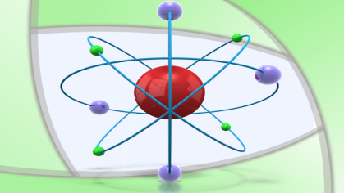
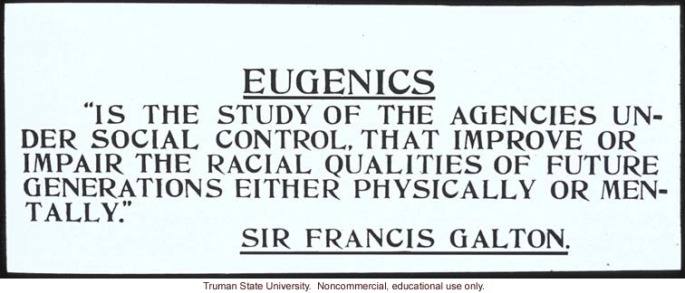
Facts
Eugenics: Greek for "well born" or "good heredity"
Nazi party began a program of forced sterilization, attempting to control racial population growth through eugenics
The “science” of eugenics was founded on the shared belief among the socially elite that human evolution culminated in the Anglo-Saxon “race.”

Slide 5
Comparison
Pro’s of Eugenics
Con’s of Eugenics
Breed desired traits into humans
Allow to screen for hereditary conditions
Overtime, it would allow for diseases to become virtually non existent
Only for elite
Who chooses the traits
Could eliminate diversity and lead to extinction
Will lead to overpopulation and resource shortages

Slide 6
Eugenics: Pros
Chance to breed desired traits into humans
- Traits can allow for ridiculously strong, smart, and
intelligent people
Modern eugenics allow physicians to screen for as many as 400 hereditary conditions
- Gives parent an accurate view of their unborn
child’s future medical needs
Women can select male donor samples that do not contain negative genetic consequences

Slide 7
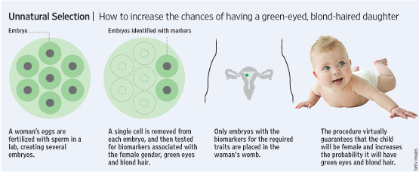
How to identify desirable traits
Whether you want a blue eyed baby……
Or you may want….

Slide 8
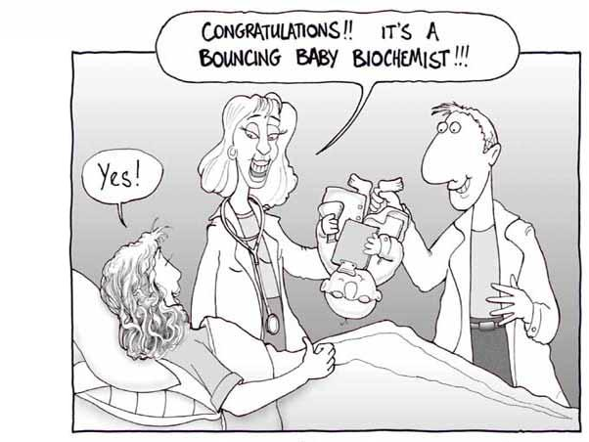
…..a baby genius

Slide 9
Eugenics: Pro
Conclusion
Breed desired traits into humans
Screen for as much as 400 hereditary conditions
Selective breeding
Can lead to diseases being virtually non existent

Slide 10
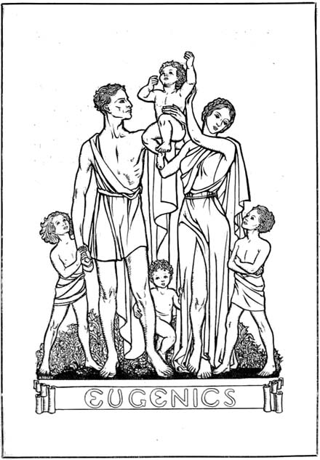
CONS
The negative sides of Eugenics
» Coercion
» Overpopulation
» Against social norms
» Decreases diversity
» Divides the Rich and
the Poor
» Inhumane/unethical
act
“A gene is either life itself, or just a useful piece of a kit.”

Slide 11
Eugenics: Cons
Only for Elite
Expensive procedure
Men in power choose the traits being kept
Overpopulation
Advanced humans will mean less deaths
Overpopulation leads to resource shortages
Coercion
Would a third party tell us who we could have children with?
To achieve perfection, this may be necessary
Only for Elite
Overpopulation
Coercion

Slide 12
Eugenics: Cons
Could potentially eliminate diversity in our species
Elimination of traits deemed undesirable would reduce genetic diversity
If everyone were designed to be 'beautiful and attractive' and alike, it would be hard to distinguish between different individuals
Unethical
Someone has the right to define what is undesirable and the right to stop other people from having children with those “undesirable” traits
Who determines what is the right thing to do in manipulating life?
How is improvement defined? How can the public be certain of the highest ethical precautions?
How is the science protected from reverting back to the same racist and misogynistic past?

Slide 13
Eugenics: Cons
Conclusion
Conclusion on Cons
Leads to Overpopulation
Resource shortages?
Only for elite
Expensive procedure
Will create a gap between rich and poor
Decreases Diversity
Could a single disease cause extinction?
Coercion of reproduction
A third party determining our reproduction
Unethical
Who chooses what traits we keep?

